Slide 1
Plots for Electrochemical Testing
Marie Millares CME502 – Mathematical Modelling

Slide 2
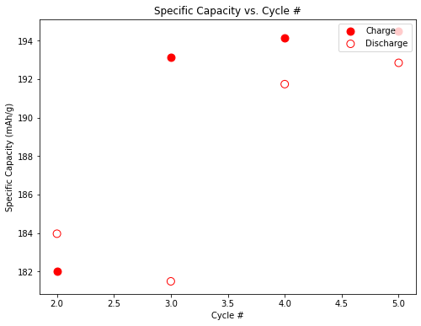
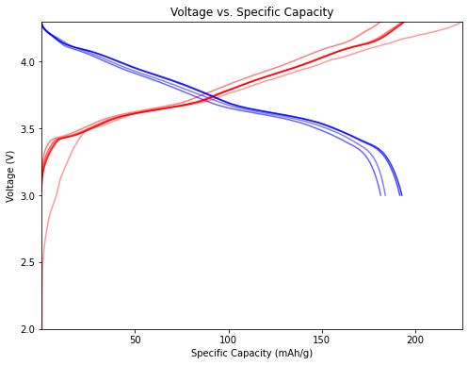
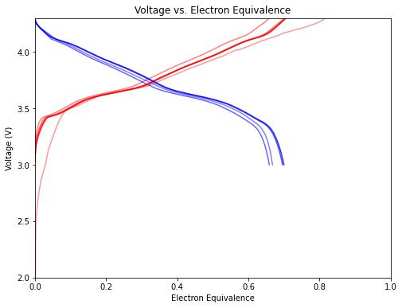
Research Background
Research Objective: Develop new materials to advance next generation batteries
Types of Preliminary Battery Testing
Charge / Discharge Cycling Test
Voltage Profiles
Depicts cell stability, energy output per cycle, and parasitic reactions
Depicts energy as a function of voltage
Depicts the number of electrons stored in material
Notes:
Whenever I start doing electrochemical tests on a battery, the preliminary data

Slide 3
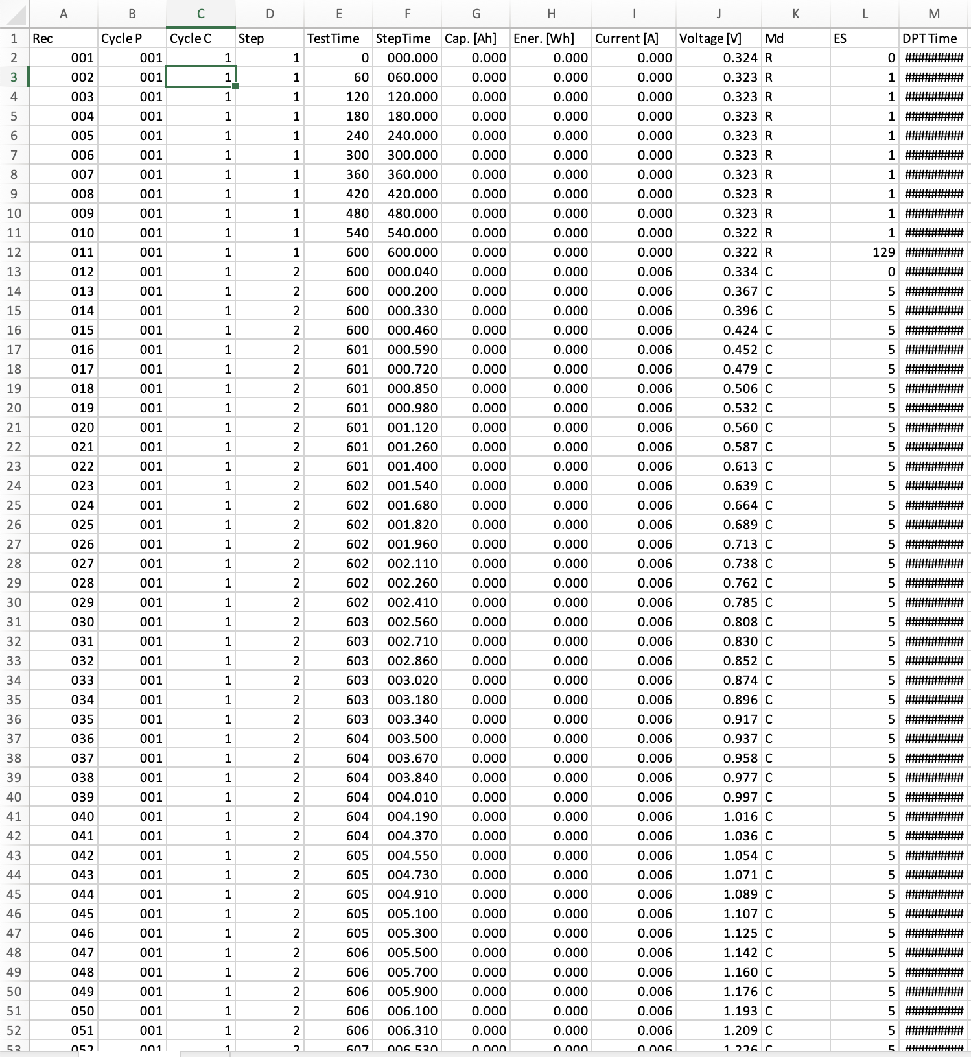
Problem
Data processing was done in excel
Each charged cycle and discharged cycle were filtered for plotting
Copy and pasted necessary information into a new excel for plotting
Required re-formatting of excel plots every time
Time consuming, inefficient

Slide 4


Project Goals
Let’s Speed Things Up!
Develop a robust code that will…
Provide a convenient user interface to input external information
Extract data from .xlsx file without overwriting original file or stored data in code
Store data in a manner that is convenient for manipulation, plotting, and any future calculations
Plot publication-ready figures
Notes:
Ie: in class when we used the open file function with ‘w’ it would rewrite original file and data would be lost

Slide 5
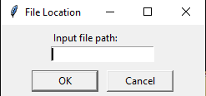
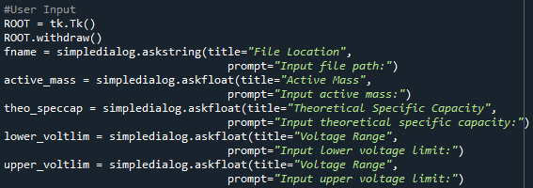
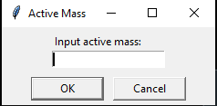
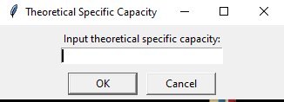
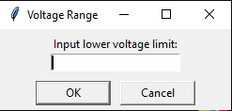
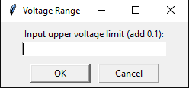
Explanation of Code: User Interface
Allows for flexibility in the code from user to user
** Active mass and theoretical specific capacity must be calculated externally, with respect to coin cell measurements
Notes:
Ie: in class when we used the open file function with ‘w’ it would rewrite original file and data would be lost

Slide 6

Rest of Code
That’s it!
Well… not really…
Notes:
Ie: in class when we used the open file function with ‘w’ it would rewrite original file and data would be lost

Slide 7
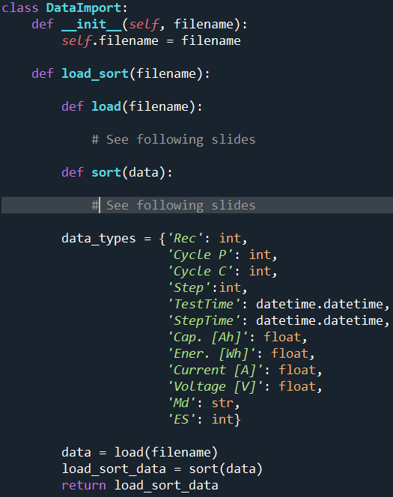
Explanation of Code: Classes
Classes organize code by bundling data and functions together
Purpose of this class is to bundle file handling functions
Created nested methods to differentiate both functionalities, but both must always be run for plotting to be correct
def load(): extracts header titles and column information from Excel files into corresponding key variables
def sort(): sorts extracted data into initialized empty dictionaries, separates data information by cycle number and charge / discharge
Notes:
Ie: in class when we used the open file function with ‘w’ it would rewrite original file and data would be lost

Slide 8
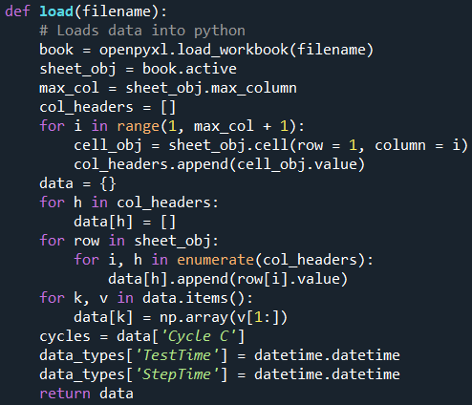
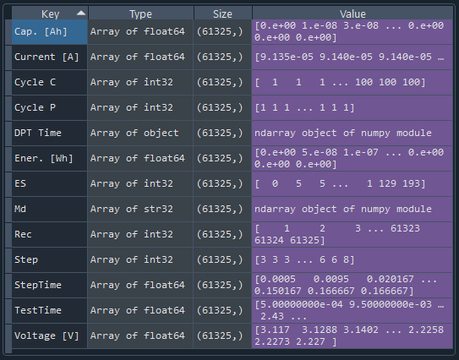
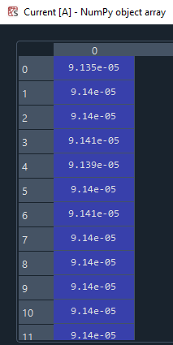
Explanation of Code: Load Method
openpyxl was used since it made handling .xlsx files easier
Headers from each column were extracted from the excel file and later populated
Notes:
Ie: in class when we used the open file function with ‘w’ it would rewrite original file and data would be lost

Slide 9
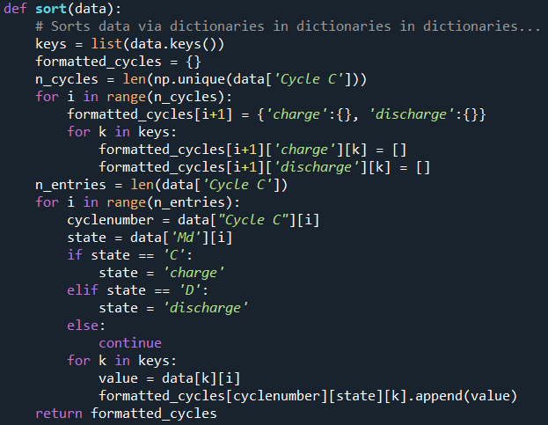
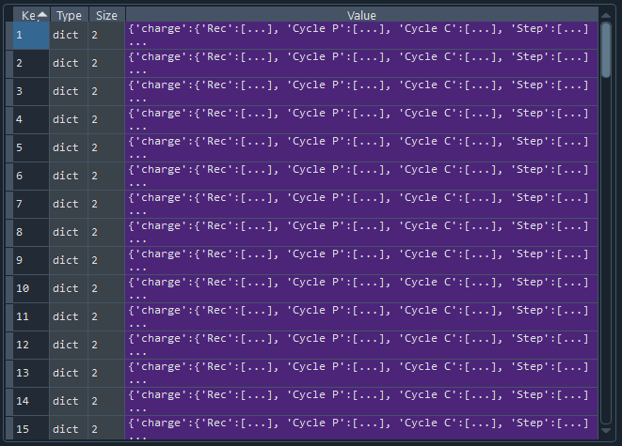
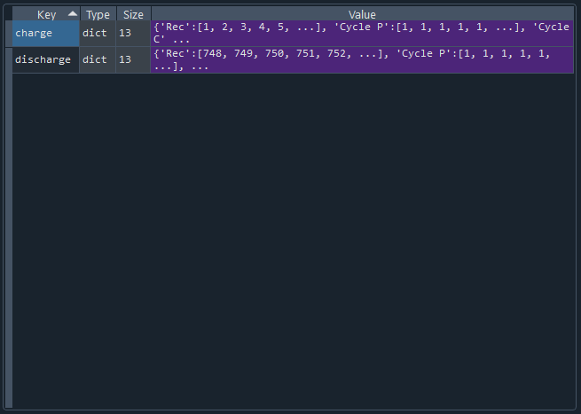
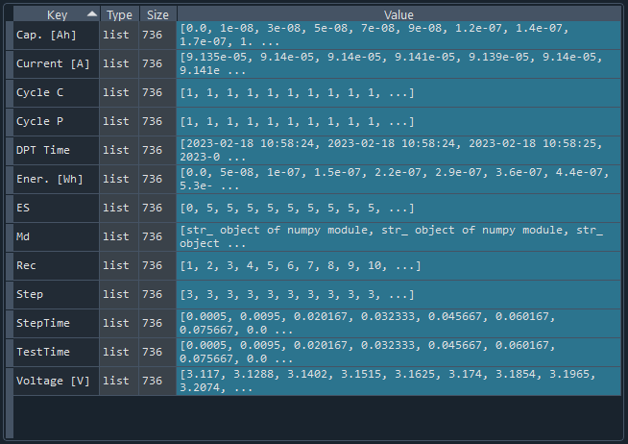
Explanation of Code: Sort Method
Sort uses the final product from the load method
Empty lists within dictionaries within dictionaries that were initialized begin populating with values
Notes:
Ie: in class when we used the open file function with ‘w’ it would rewrite original file and data would be lost

Slide 10
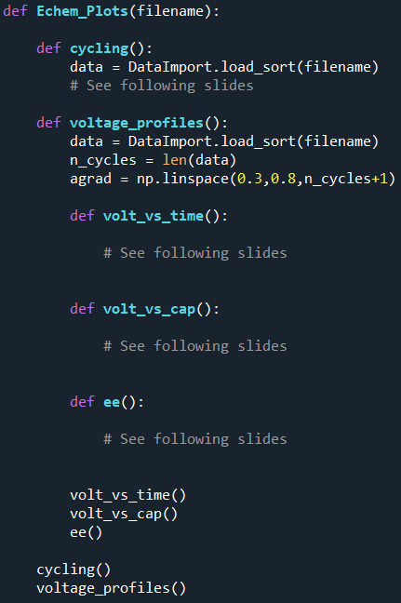
Explanation of Code: Plotting
Uses method from DataImport class
Nested function containing desired plots
Flexible so that more plots can be added in the future
Notes:
Ie: in class when we used the open file function with ‘w’ it would rewrite original file and data would be lost

Slide 11
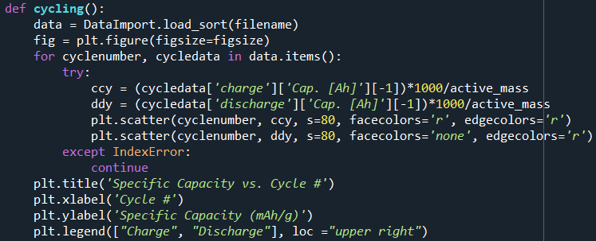
Results: Cycling Tests
Data is normalized to the battery’s active mass, which was a user input earlier
Able to identify SEI formation due to the large specific capacity after the first discharge
Notes:
Ie: in class when we used the open file function with ‘w’ it would rewrite original file and data would be lost

Slide 12
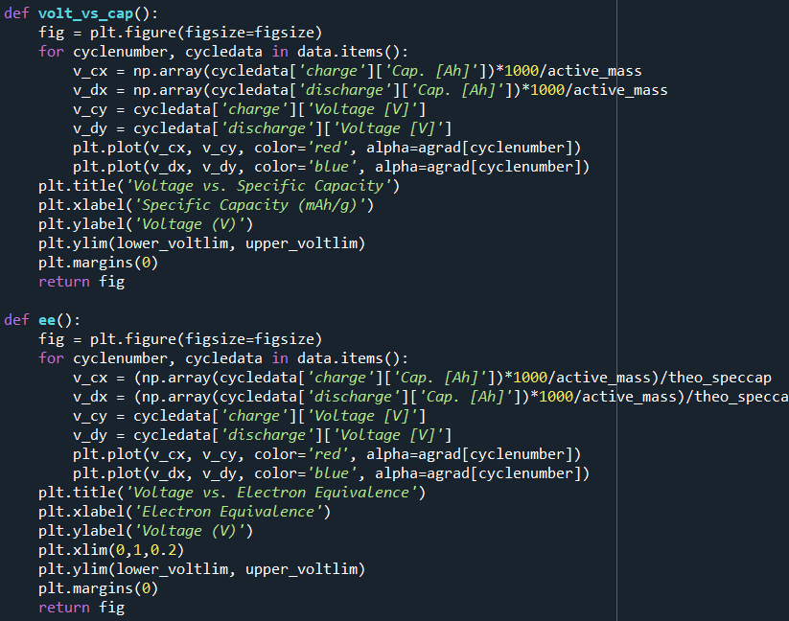
Results: Voltage Profiles
Data is normalized to the battery’s active mass, which was a user input
Voltage range for y-axis is determined by user input
Electron equivalence is calculated using theoretical capacity and active mass
Material we are plotting is a high voltage material– it is showing stability in that region based off the profiles
Notes:
Ie: in class when we used the open file function with ‘w’ it would rewrite original file and data would be lost

Slide 13
Conclusions and Future Work
Will save me lots of time and expedite research progress
Had lots of fun coding the program and found it to be super useful
Learned more about classes
Make more plots! Particularly rate capability and dQ/dV
Include a coulombic efficiency axis for cycling plot
Notes:
Ie: in class when we used the open file function with ‘w’ it would rewrite original file and data would be lost

